Slide 1
University Admission Prediction
MANIDEEP DONKA
KARAGGI SARAT CHANDRA
APPALA YASWANTH
SAMARENDRA NIMMALA

Slide 2
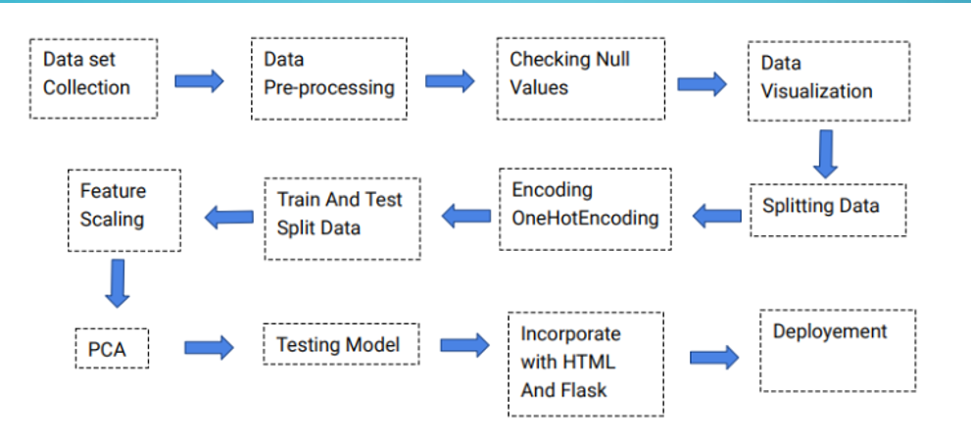
BLOCK DIAGRAM

Slide 3
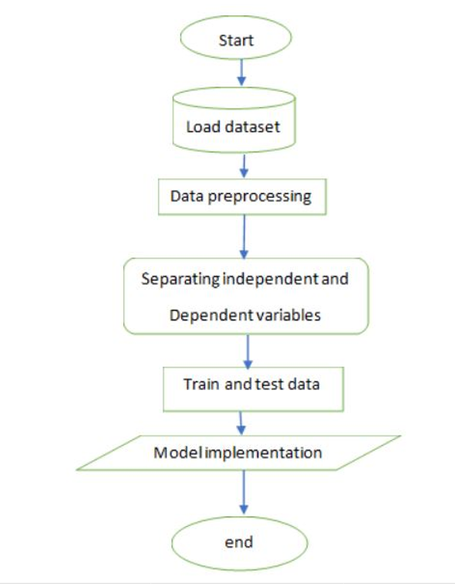
FLOW CHART

Slide 4
SOFTWARE DESIGNING
● Jupyter Notebook Environment
● Spyder Ide
● Machine Learning Algorithms
● Python (pandas, numpy, matplotlib, seaborn, sklearn)
● HTML
● Flask
We developed this university admission prediction by using the Python language which is a interpreted and high level programming language and using the Machine Learning algorithms. For coding we used the Jupyter Notebook environment of the Anaconda distributions and the Spyder, it is an integrated scientific programming in the python language. For creating a user interface for the prediction we used the Flask. It is a micro web framework written in Python. It is classified as a micro framework because it does not require particular tools or libraries. It has no database abstraction layer, form validation, or any other components where pre-existing third-party libraries provide common functions, and a scripting language to create a webpage is HTML by creating the templates to use in the functions of the Flask and HTML.

Slide 5
ADVANTAGES AND DISADVANTAGES
Advantages:
●The first is the ability to determine the relative influence of one or more predictor variables to the criterion value.
●The second advantage is the ability to identify outliers, or anomalies.
●It is composed using the HTML and Python for the web usage in real time.
●Multi Linear regression gave the accurate result of the prediction up to 87.5% which is the algorithm we used for prediction.
●It can work in real time and predict as soon as the necessary details for prediction are given to the model.It can work in real time and predict as soon as the necessary details for prediction are given to the model.

Slide 6
Disadvantages:
● disadvantage of using a multiple regression model usually comes down to the data being used.
● It could not work anywhere like a web-application, if one is using other should be static.
● Needs multiple value for the prediction.

Slide 7
APPLICATIONS
● we use Machine Learning Algorithms to analyze the data and helps students in shortlisting universities with their profiles.
● Navigating the chance of admit through the site is easy
● This model allow the students to save the extra amount of time and money that they would spend on education consultants and application fees for the universities.

Slide 8
CONCLUSION
The aim is to construct a robust model that simultaneously estimates the chance of admit. For the project , University Admission Prediction Multi Linear regression provides greater accuracy than the other regression algorithms which are Decision tree and Random forest. Multi Linear regression algorithm provides 87.5% accuracy

Slide 9
BIBLIGRAPHY
● Abdul Fatah S; M, A. H. (2012). Hybrid Recommender System for Predicting College Admission, pp. 107–113.
● Eberle, W., Simpson, E., Talbert, D., Roberts, L. and Pope, A. (n.d.). Using Machine Learning and Predictive Modeling to Assess Admission Policies and Standards.
● Jamison, J. (2017). Applying Machine Learning to Predict Davidson College ’ s Admissions Yield, pp. 765–766
● Mane, R. V. (2016). Predicting Student Admission decisions by Association Rule Mining with Pattern Growth Approach, pp. 202–207.
● Master Portal (2017). Master Portal. URL: http://www.mastersportal.eu/countries/82/united-states.html

